Slide 1
XI Reactor Material Science Conference, Dimitrovgrad,
Russia, 27-31 May 2019
Effect of neutron irradiation in the VVER-1000 reactor on the characteristics of secondary phases in zirconium alloys E110 and E635
© A.V.Obukhov, G.P.Kobylyansky, S.S.Sagalov, and A.R.Belozerova, 2019 (JSC “SSC RIAR”, Dimitrovgrad)

Slide 2
Introduction
Secondary phase precipitates in zirconium-based alloys which have been used as materials for the VVER-1000 core components, are structural constituents and they go through different changes under irradiation.
Changes in the characteristics of secondary phases can lead to changes in the operational performance of the nuclear reactor core components, for instance, fuel claddings and guide tubes, with a potential impact on their operational integrity. Therefore, it is considered of great importance to study changes in phase composition of zirconium alloys E110 and E635 to verify operational integrity of components made of the aforesaid alloys during the entire operational lifetime.
This paper is focused on investigation of the E110 (Zr-1%Nb) phase composition as it is a fuel cladding materials and E635 (Zr-1%Nb-0.4%Fe-1.2%Sn) phase composition as it is a guide tube materials after their operation in the VVER-1000 reactor. In particular, described here are changes in the elemental composition of β-Nb and Laves phases.
2

Slide 3
Equipment used
Transmission electron microscope enabling operation at an accelerating voltage of 200 kV
Electron probe X-ray microanalysis instrument which employs the INCA X-MAX TEM 80 system
Electrolytic equipment TENUPOL-5 designed for electrolytic thinning
Semiconductor detector ORTEC GEM10P4-70PL made of high purity germanium and multichannel analyzer ORTEC DSPEC jr 2.0 for gamma-spectrometry
Equipment for sample preparation in the hot cell
3

Slide 4
Objects under investigation
The specimens were cut out from several irradiated fuel claddings and guide tubes at different elevation levels. Their operating time was different too. Thus, it was possible to obtain irradiation-induced damage data as to different extent of damage and irradiation temperatures.
Operating time, yr. | Object under investigation | Alloy | Damage dose, dpa | Irradiation temperature, ^{о}С
3 | Fuel cladding | E110 | 2 - 11 | 300-340
 | Guide tube | E635 | 2.5 - 10 | 290-320
5 | Fuel cladding | E110 | 2 - 17 | 300-340
 | Guide tube | E635 | 2.5 - 16 | 290-320
4

Slide 5
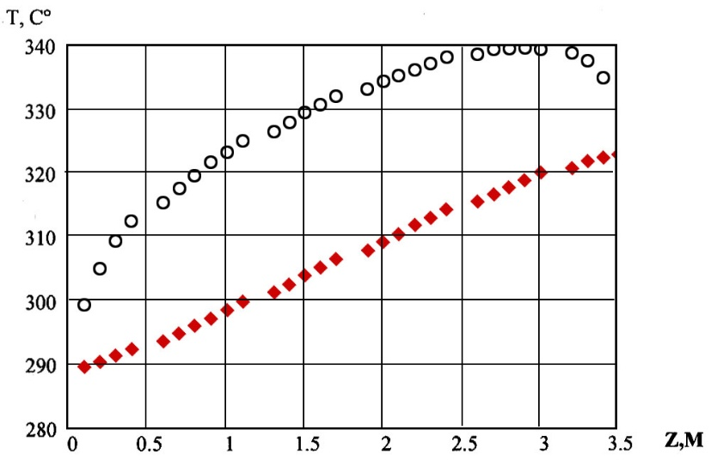
Irradiation temperature
The irradiation temperature of the test specimens was obtained based on the calculated temperature data profile on the surface of fuel cladding (black points) and guide tube (red points) throughout the height [1].
[1] - V. V. Svetukhin. Modeling of corrosion kinetics for Zr claddings of the VVER-1000 fuel rods/ V.V. Svetukhin, A. E. Novoselov, G. P. Kobylyansky[etc]// Collected papers. Modeling of reactor materials performance under irradiation. – under the editorship of V. V. Svetukhin, Ph.D, V. N. Golovanov, Ph.D and V. D. Risovany – Ulyanovsk: Ulyanovsk state University. – 2007. - Pp.91-98
5

Slide 6
Damage dose estimation
Damage dose (Kt) was estimated to compare microstructure parameters of the test specimens cut out from the fuel claddings and guide tubes. The following work was done for this purpose:
Gamma emission spectrum recording that was followed by the analysis of ⁹⁴Nb lines.
Calculation of specific activity (А).
Neutronic calculations of damage dose with the use of code UPM_PREPRO-2017_FENDL-2.0_ENDF/B-VII.0_Spectr based on a priori neutron spectrum for the VVER-1000 core.
Кt = A/86.485
There were only the ⁹⁴Nb line in the built-up gamma spectrum that is why reconstruction of neutron spectrum did not allow for affecting its shape so the reference spectrum was taken (the neutron spectrum was normalized as to the reactor power level).
6

Slide 7
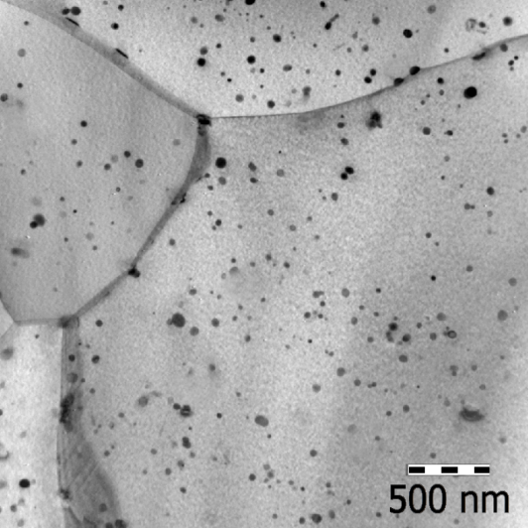
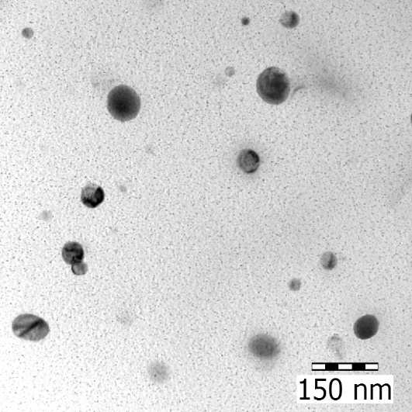
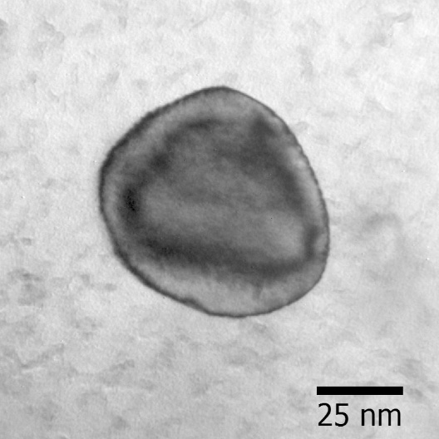
β-Nb phase in alloy E110 before irradiation
It is a basic phase in the binary alloys Zr-Nb (E110, E125), it has BCC-crystalline lattice with a parameter а=0.331 nm.
D_{av}, µm | ρ, 10¹⁹ m⁻³ | V fraction, %
~ 45 | ~ 20 | 1.7
Nb 85 – 90 at.%
(extraction replica)
7

Slide 8
Changes in the elemental composition of the β-Nb phase under irradiation
The composition of the β-Nb phase particles depends on their size and damage dose:
the smaller diameter the less is the percentage composition of Nb;
The higher the damage dose the less is Nb content.
8

Slide 9
Changes in the elemental composition of the β-Nb phase under irradiation
Nb content in the particles of the β-Nb phase with a diameter of 50 nm and 150 nm in relation to the attained damage dose at an irradiation temperature of 330^{о}С
Nb content in the irradiated particles of the β-Nb phase in relation to the irradiation temperature
Ingress of Zr from the matrix to the β-Nb phase leads to changes in size, concentration, and volume concentration of phase particles. BCC-lattice is preserved.
Damage dose | D_{av}, nm | ρ, 10¹⁹ m⁻³ | V fraction, %
0 dpa | ~ 45 | ~ 20 | 1.7
15 dpa | ~ 52 | ~ 12 | 1.2
9

Slide 10
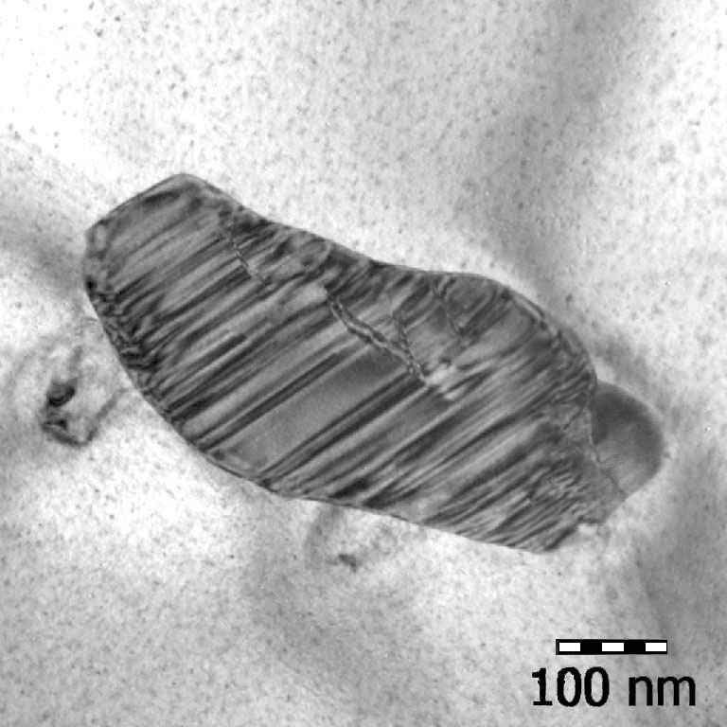
Laves phase Zr(Nb,Fe)₂ in alloy E635 before irradiation
HCP а=5.3 Å, с=8.7 Å ${\overline{D}}_{eq.}≈100 nm ρ ≈3∙{10}^{19}{ m}^{−3}$
10

Slide 11
Changes in the elemental composition of the Laves phase Zr(Nb,Fe)₂ under irradiation
Under neutron irradiation Fe atoms leaves the Laves phase particles Zr(Nb,Fe)₂ and enters the matrix and thus the elemental composition of particles and matrix changes.
Specimens were cut out from the guide tube (Т_{irr}=310 ^{о}С)
11

Slide 12
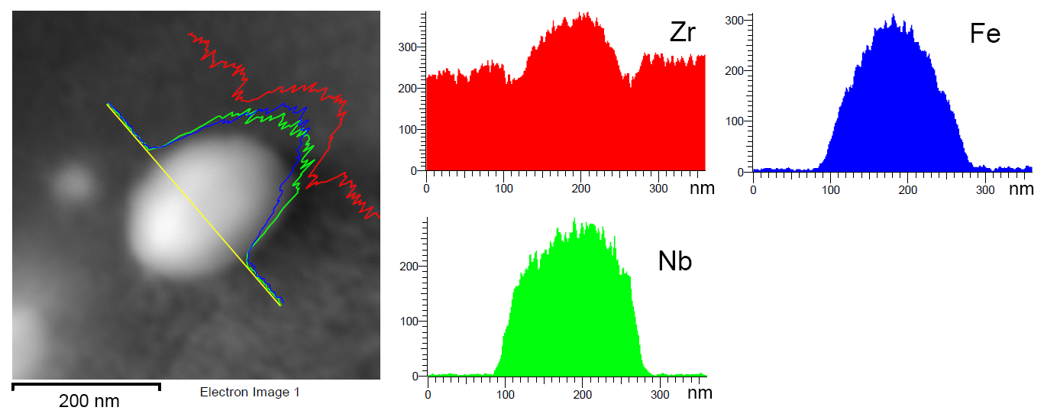
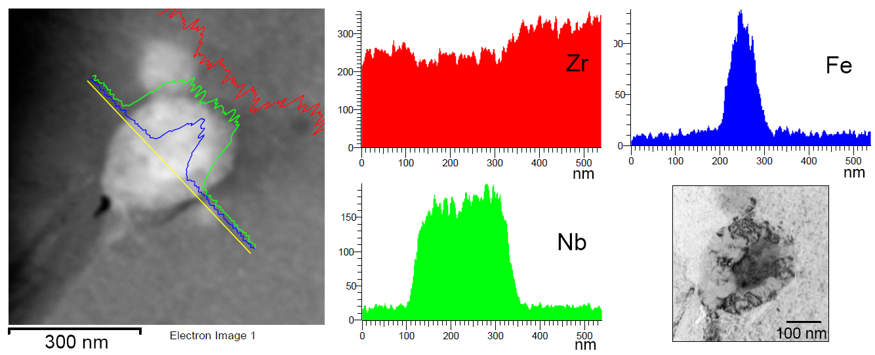
Changes in the elemental composition of the Laves phase Zr(Nb,Fe)₂ under irradiation
Fe leaves the particles of the Laves phase Zr(Nb,Fe)₂ and enters the matrix beginning with the periphery
Damage dose
2.5 dpa
Т_{irr}=310^{о}С
Damage dose
13 dpa
Т_{irr}=310^{о}С
12

Slide 13
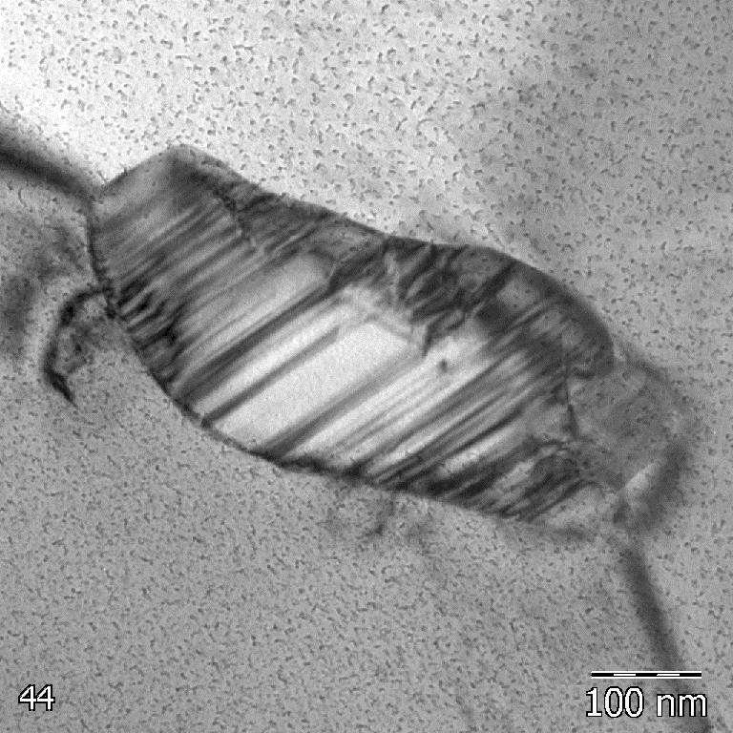
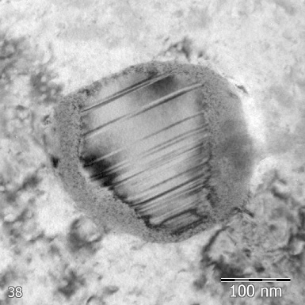
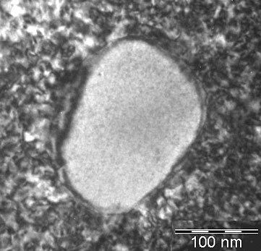
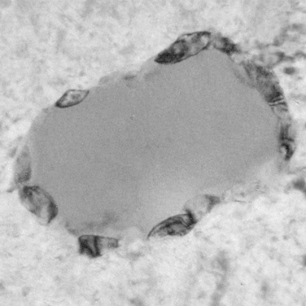
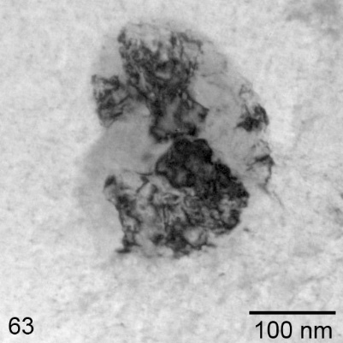
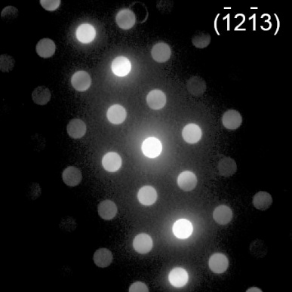
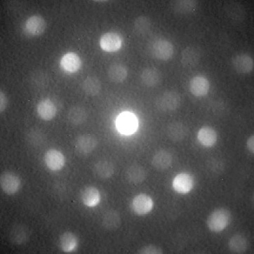
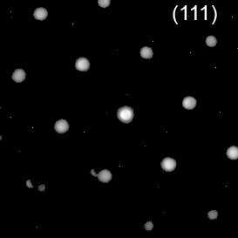
Transformation of Laves phase Zr(Nb,Fe)₂ under irradiation
Single-crystal Laves phase transforms into polycrystalline phase β-Nb in stages
Unirradiated
Stage I
Stage II
Stage III
Stage IV
β-Nb
HCP
BCC
13

Slide 14
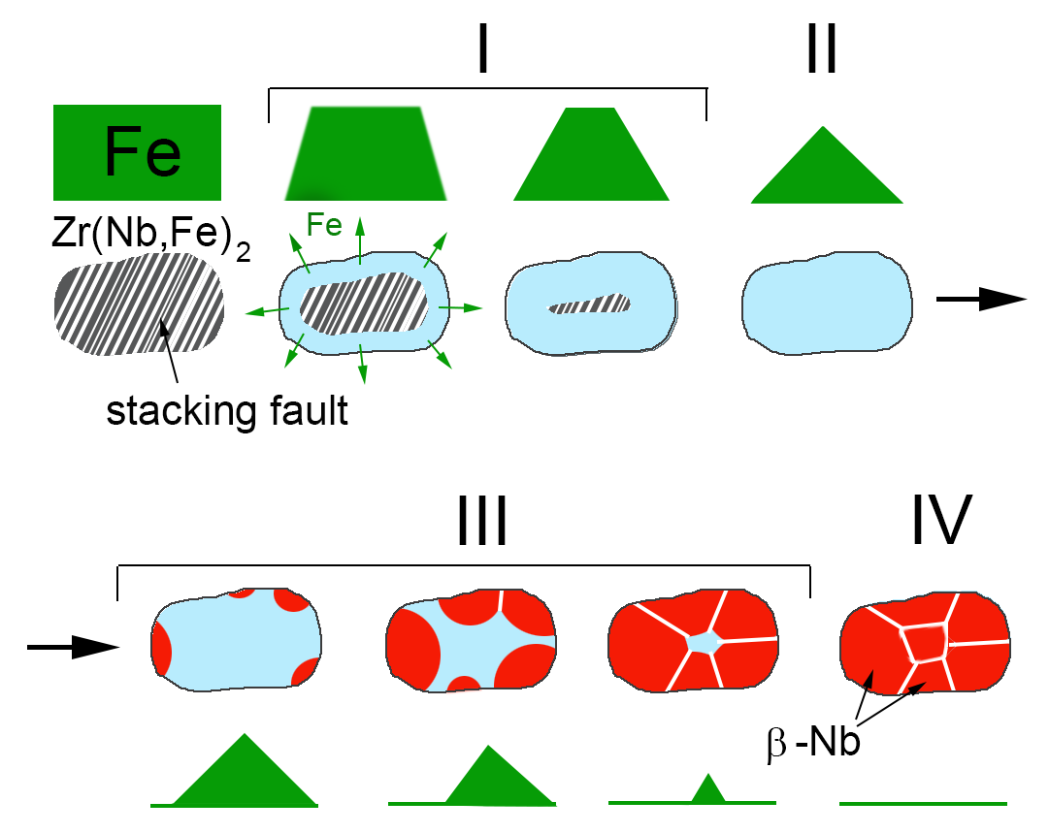
Transformation of Laves phase Zr(Nb,Fe)₂ under irradiation
Schematic representation of the stage-by-stage transformation
HCP
BCC
14

Slide 15
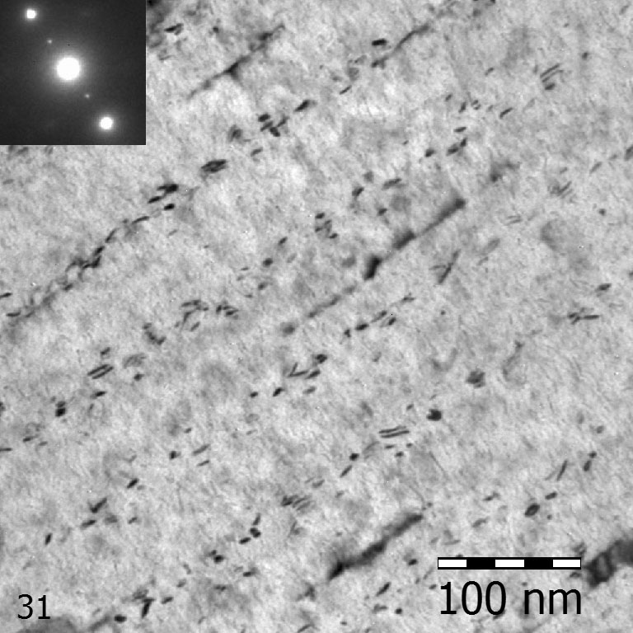
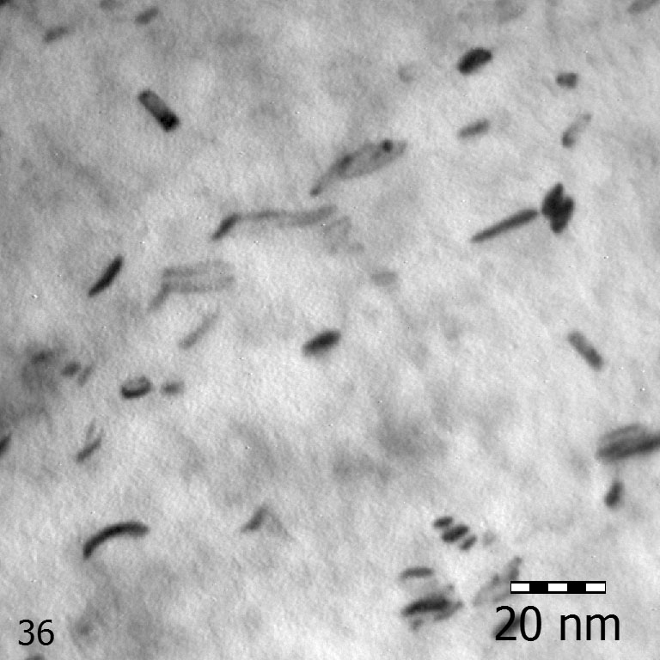
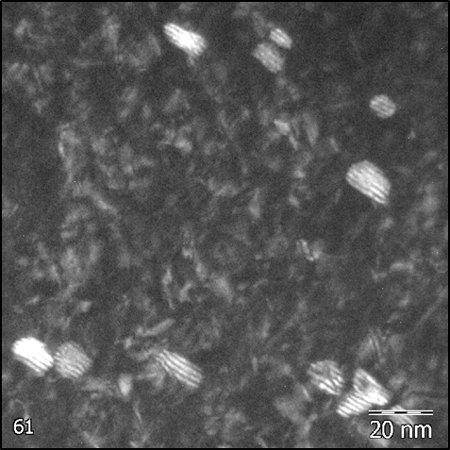
Radiation-induced finely dispersed phase
Finely dispersed laminary phase forms under irradiation in E110 and E635 alloys.
a
b
c
Particles of radiation-induced finely dispersed phase in alloy E110 after neutron irradiation up to a damage dose of 12 dpa (a, b) and 9 dpa (c).
15

Slide 16
Radiation-induced finely dispersed phase
Finely dispersed phase is larger in alloy E110 and its concentration is 7 times higher compared to alloy Э635.
Alloy E110
Alloy E635
~ 6 nm
~ 3 nm
17∙10²¹ m⁻³
2,5∙10²¹ m⁻³
16

Slide 17
Conclusions
Neutron irradiation in a temperature range of 290ºC to 340^{о}С results in significant changes in parameters of the secondary phases.
β-Nb
Nb content in the particles depends on their size and irradiation temperature: the smaller the particle and lower the irradiation temperature, the lower is percentage composition of Nb. The higher is the damage dose, the percentage composition of Nb becomes lower in the particles, their size increases, concentration decreases but the BCC-structure is preserved.
Laves phase Zr(Nb,Fe)₂
If damage dose is lower than 15 dpa, Fe content in the particles depends on their size (the smaller the particle, less Fe it contains). Further irradiation leads to Fe escapes from the phase and enters the matrix , and thus the crystalline lattice transforms from HCP into BCC in stages. Transformation begins with the periphery and propagates towards the center of particles. As a result, initial single-crystal Laves phase becomes polycrystalline composed of the β-Nb grains. Further irradiation does not change the composition of new polycrystalline phase and its size.
Radiation-induced phase
Neutron irradiation in a temperature range of 290ºC to 340^{о}С leads to formation of radiation-induced finely dispersed laminary phase β-Nb of size no more than 10 nm in alloys E110 and E635. Its concentration attains the saturation (17·10²¹m⁻³ for E110 ) once the damage dose higher than 10 dpa has been attained. Concentration of phase particles is 7 times higher in alloy E110 compared to alloy Э635.
17

Slide 18
THANK YOU FOR YOUR ATTENTION!
A.V. Obukhov, Senior Researcher
Tel: 8(84235)94947
E-mail: gpk@niiar.ru

